Slide 1
Nissan LEAF
David Roper
http://arts.bev.net/roperldavid/

Slide 2
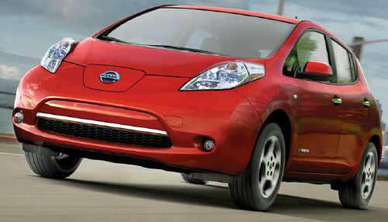
LEAF Roper
Cayenne-red color

Slide 3
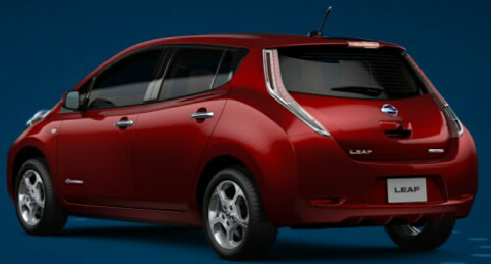
LEAF Roper

Slide 4
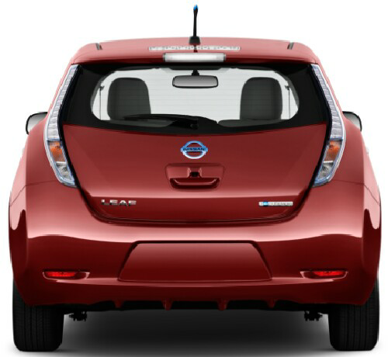
LEAF Roper

Slide 5
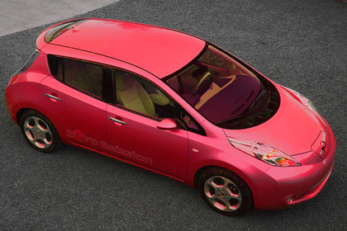
LEAF Roper

Slide 6
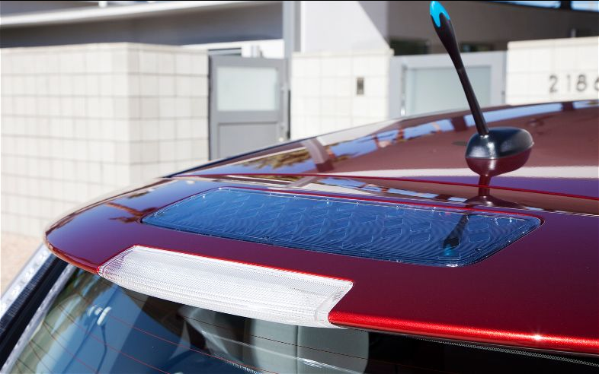
LEAF Roper
Solar panel trickle charges the 12-volts battery (SL model only).
Antenna is for AT&T connection to Nissan.

Slide 7
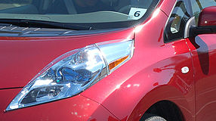
LEAF Roper
Headlight design channels air flow above the side mirror.

Slide 8
LEAF Air Flow
Reduces drag due to side mirrors

Slide 9
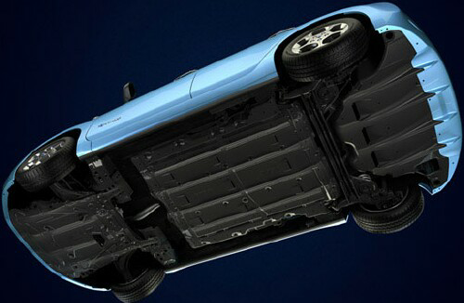
LEAF Underneath
Smooth underbody reduces drag.

Slide 10
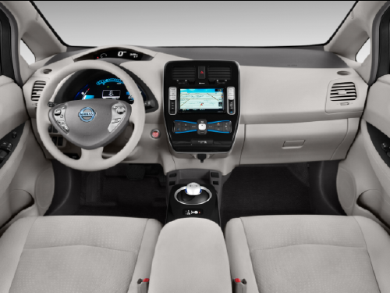
Dash

Slide 11
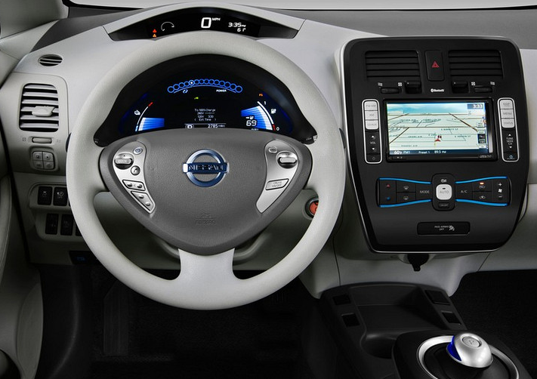
Dash

Slide 12
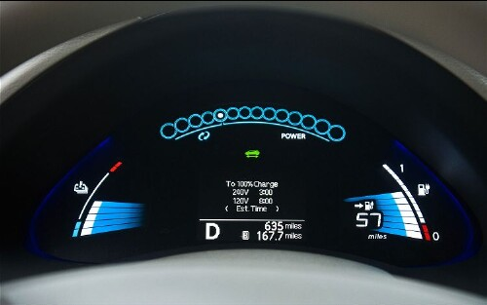
Dash

Slide 13
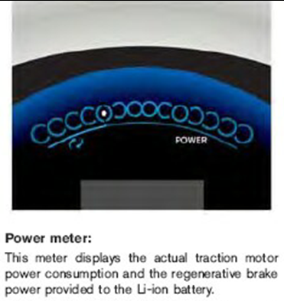
Dash

Slide 14
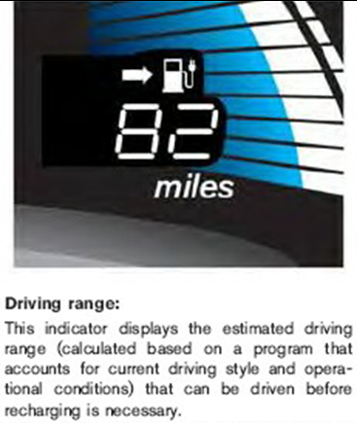
Dash

Slide 15
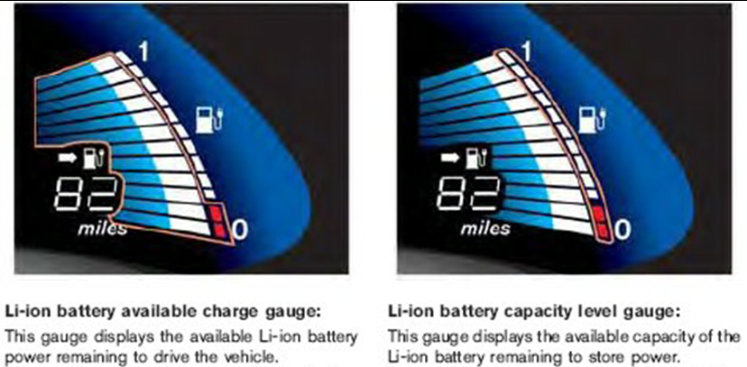
Dash

Slide 16
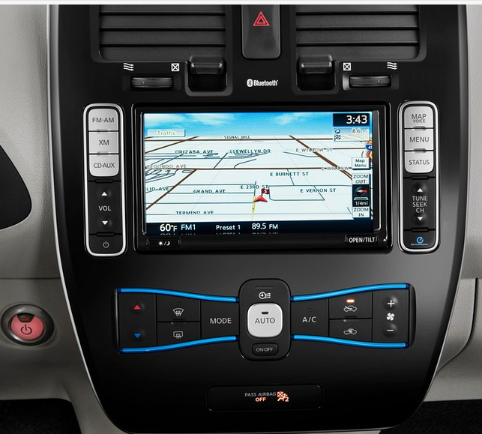
Center Display

Slide 17
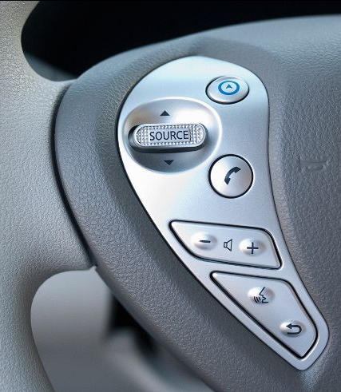
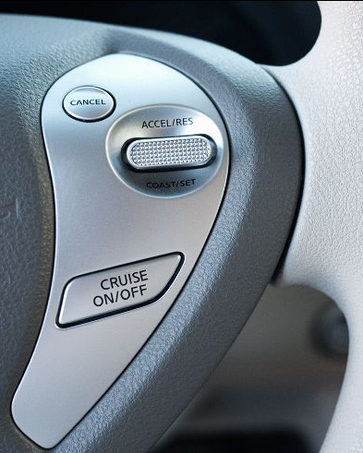
Quick Controls
Top button shows driving range on center display.

Slide 18
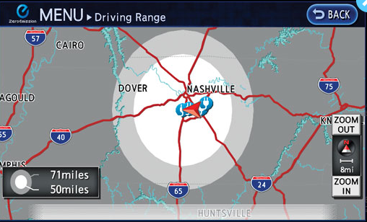
Driver Controls
Pushing a button on steering wheel shows nearby charging stations.

Slide 19
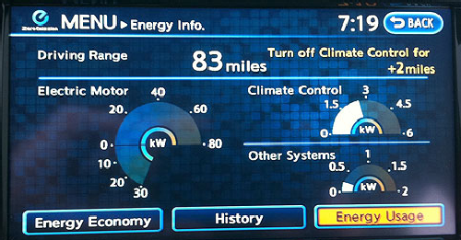
Energy Display

Slide 20
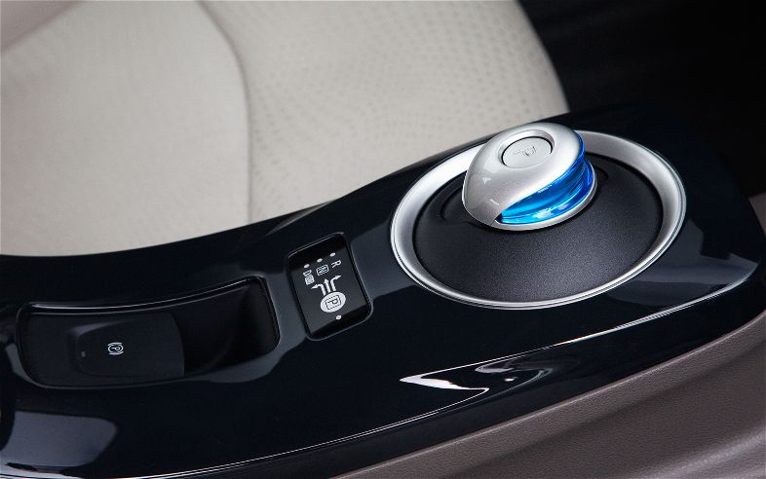
Shift Knob
Shifting into D twice actuates ECO mode.

Slide 21
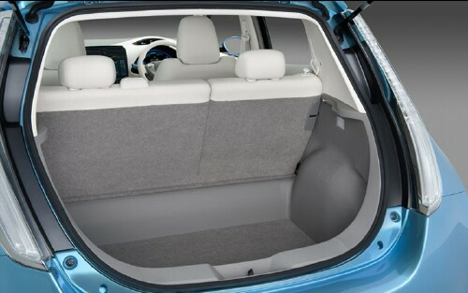
Trunk
SL model has cargo cover.

Slide 22
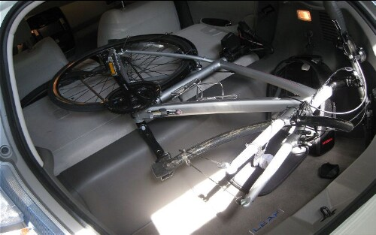
Trunk

Slide 23
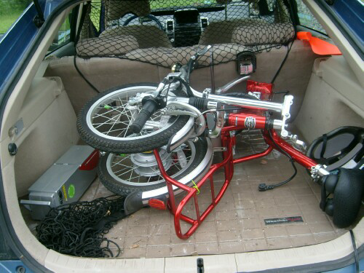
Trunk
IZIP Via Mezza electric-assisted folding bicycle.

Slide 24
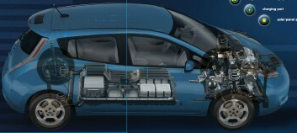
Body Cutaway

Slide 25
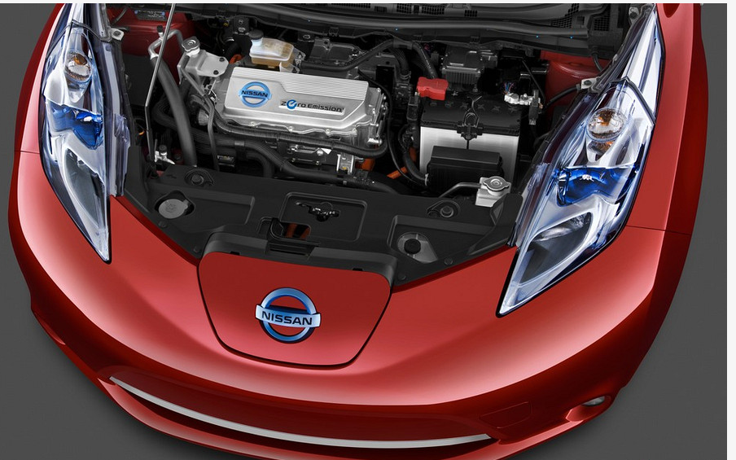
Under Hood

Slide 26
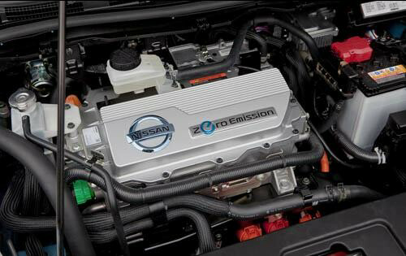
Under Hood

Slide 27
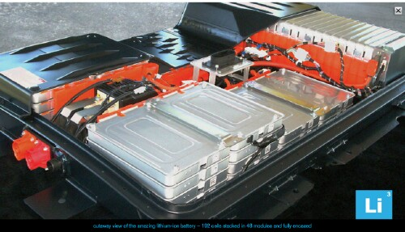
Battery Cutaway

Slide 28
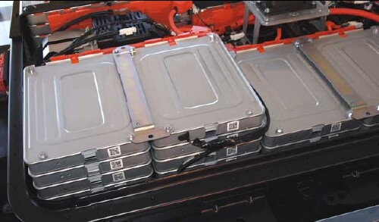
Battery Cutaway

Slide 29
Charging an Electric Car
Level-1: 120-Volts AC 12-Amperes
20-kWh battery fills in ~15 hours
Level-2_15A: 240-Volts AC 15-Amperes
20-kWh battery fills in ~7 hours
Level-2_30A: 240-Volts AC 30-Amperes
20-kWh battery fills in ~3.5 hours
Level-3: 480-Volts DC 125-Amperes
20-kWh battery fills in ~0.5 hours
SL LEAF model only

Slide 30
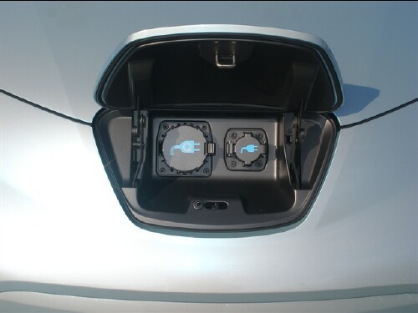
Chargers

Slide 31
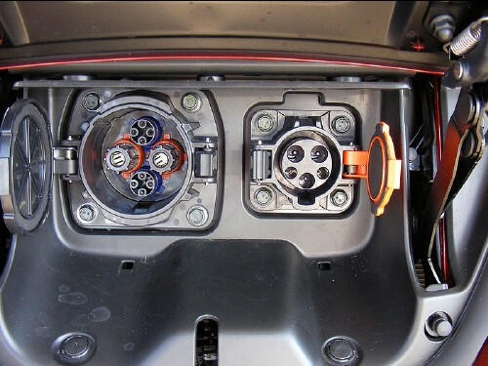
Chargers
Level-3 port on left for SL model only.

Slide 32
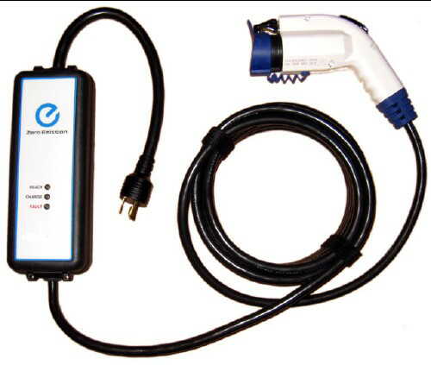
Chargers
Can be converted to level-2/240-volts.
Level-1 charging cable (EVSE)

Slide 33
EVSE Modifications
There is a hole under the release handle in which a small pad lock could be inserted to prevent the release button from being pushed in to unplug it from the car. It is called the Electric-Vehicle-Supply-Equipment (EVSE) cable. There is an aftermarket modification to it the allows it to plug into a normal U.S. 240-volts plug to use as a level-2 charger (http://evseupgrade.com/styled/ ).

Slide 34
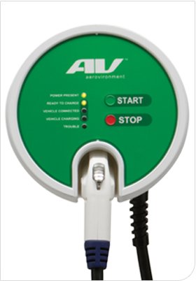
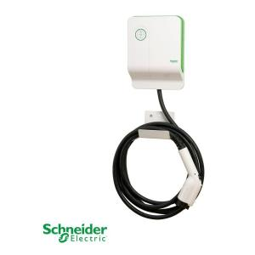
Chargers
The one Nissan sells. The one Dave Roper has.
Level-2 chargers

Slide 35
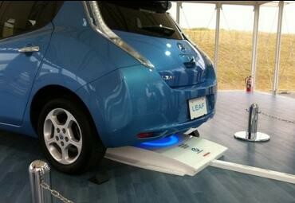
Wireless Induction Charger
The one Nissan is developing. Evatran in Wytheville VA is developing one that goes in front.

Slide 36
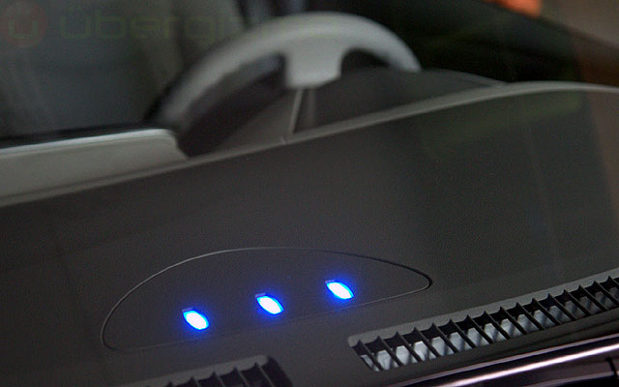
Battery Charging Status
Charging indicators inside windshield. This shows that the battery is fully charged.

Slide 37
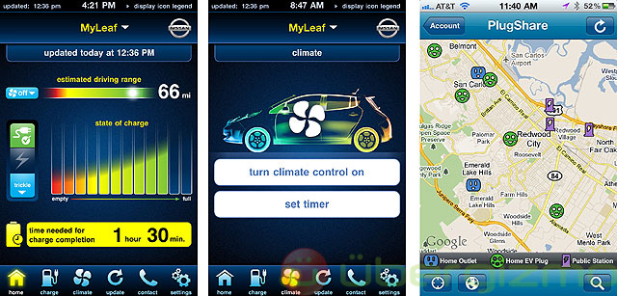
Apps for Cell Phones/Internet

Slide 38
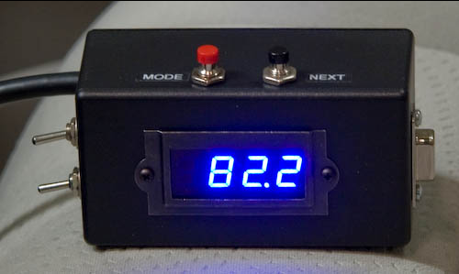
SOC Meter connects to OBD2

Slide 39
LEAF Range
town
interstate

Slide 40
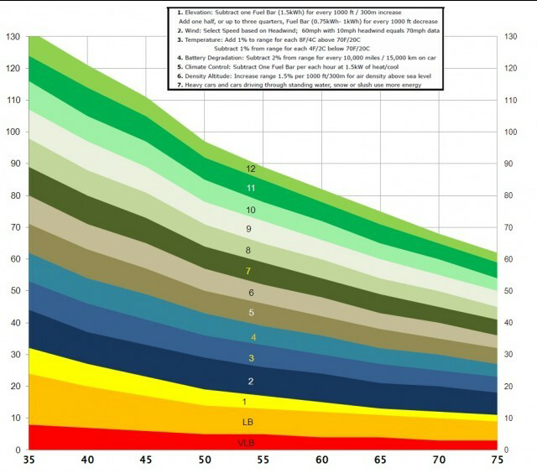
LEAF Range

Slide 41
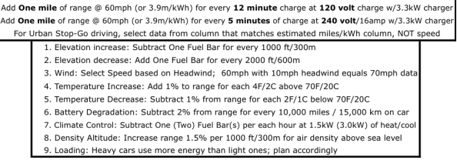
Range (miles) vs Speed (mph)

Slide 42
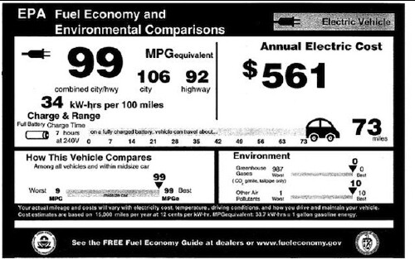
EPA Ratings

Slide 43
Driving a LEAF in the NRV
Blacksburg to Floyd & back
Blacksburg to Roanoke & back charging 2 hours @ Virginia Museum of Transportation
Blacksburg to Pulaski & back
Christiansburg to Pearisburg & back
Christiansburg to Wytheville & back charging 3 hours at Blue Ridge Nissan or Evatran
Blacksburg to Salem & back
Blacksburg to Mt. Lake & Cascades Park and back

Slide 44
New for 2012
Battery heater
Heated outside mirrors
Heated steering wheel
Heated front and outside rear seats
Rear HVAC duct
Charger increased from 3.3 kW to 6.6 kW.

Slide 45
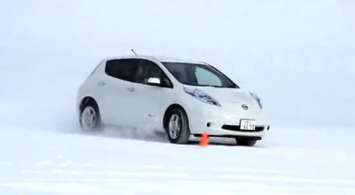
LEAF Drive Through Water & Snow

Slide 46
Extras for SL Model
Level-3 charge port
Solar panel to trickle charge 12-volts battery
Backup camera
HomeLink for controlling garage doors
Fog lamps
Cargo cover

Slide 47
Why Lease a LEAF
Reduce carbon emissions per mile traveled
Reduce use of fossil fuels per mile traveled
Reduce use of energy per mile traveled
Reduce traffic noise
Improve vehicle performance
Increase driving mindfulness
Increase public knowledge of electric cars
Increase desirability of renewable energy
EV technology will greatly improve in 3 years.

